Slide 1
Mechanisms and Robotics DE ES DM ZG561
Lecture - 2

Slide 2
Fundamentals of Robot Technology
Robot Anatomy
Arm Configuration
Joint Notation scheme
Degrees of Freedom (DOF)
Required DOF in a Manipulator
Wrist Configuration
Design & Control issues
Manipulation & Control
Robot specifications

Slide 3
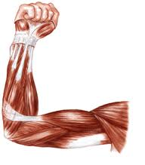
Human Arm Characteristics

Slide 4
Joints and Joint Notation Scheme
Types of Robot Joints
Type | Notation | Symbol | Description
Revolute | R |  | Rotary motion about an axis
Prismatic | P or L |  | Linear motion along an axis

Slide 5
Required Degrees of Freedom
For moving objects placed on a line or a circle → 1 dof
For moving objects anywhere on a flat surface → 2 dof
Picking objects anywhere on a 3D space → 3 dof
Reaching in to complex profiles → > 3 dof

Slide 6
Arm Configurations
S. No. | Configuration | Joints
1. | Cartesian | (3 Linear joints)
2. | Cylindrical | (2 Linear joints, 1 Rotary Joint)
3. | Polar (Spherical) | (1 Linear joint, 2 Rotary joints)
4. | Articulated (jointed arm) | (3 Rotary Joints)

Slide 7
Arm Configurations

Slide 8
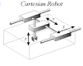
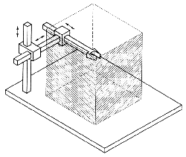
Robot Configurations
Cartesian

Slide 9
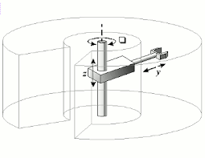
Robot Configurations
Cylindrical

Slide 10
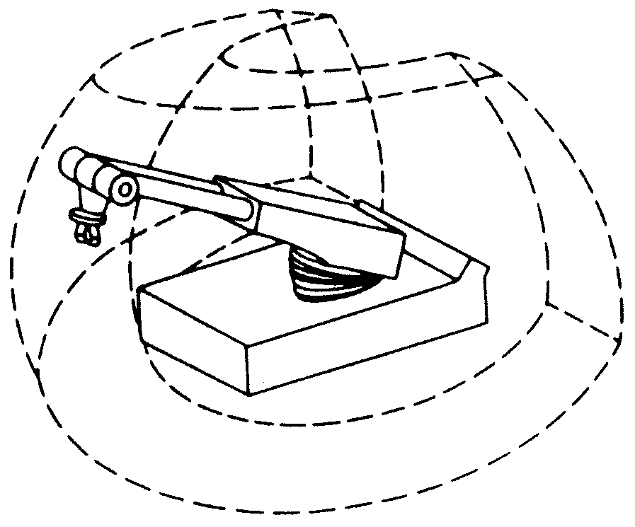
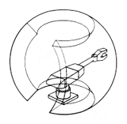
Robot Configurations
Spherical

Slide 11
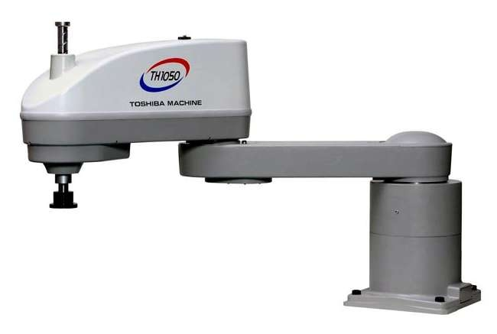
Robot Configurations
SCARA (Selective compliance assembly robotic arm)
A variation of the cylindrical configuration involving, 1 linear joint and 2 rotary joints

Slide 12
Arm Configurations
S. No. | Configuration | Joints
1. | Cartesian | (3 Linear joints)
2. | Cylindrical | (2 Linear joints, 1 Rotary Joint)
3. | Polar (Spherical) | (1 Linear joint, 2 Rotary joints)
4. | Articulated (jointed arm) | (3 Rotary Joints)

Slide 13
Robot Configurations and Work Envelope
Cartesian
Work Volume or Work Envelope is a term that refers to the space within which a robot can manipulate its wrist’s end

Slide 14
Robot Configurations and Work Envelope
Cylindrical

Slide 15
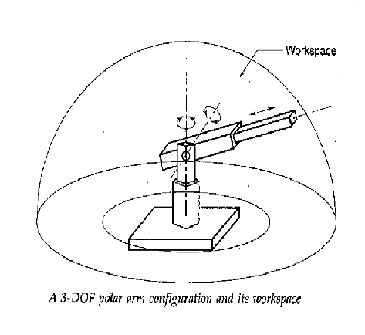
Robot Configurations and Work Envelope
Polar

Slide 16
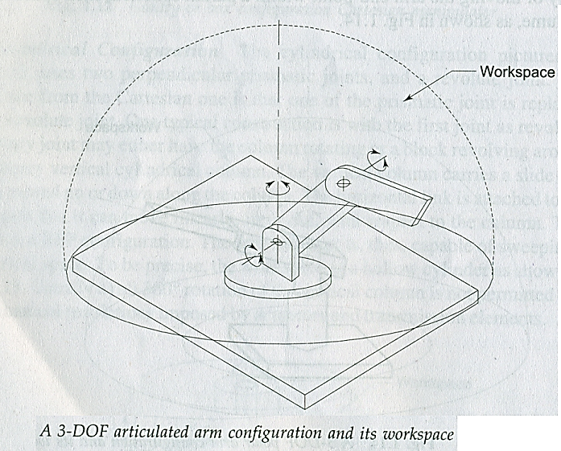
Robot Configurations and Work Envelope
Jointed Arm Configuration

Slide 17
Robot Configurations
Selective compliance assembly robotic arm
SCARA ()
A variation of the cylindrical configuration, involving
1 linear joint and 2 rotary joints

Slide 18
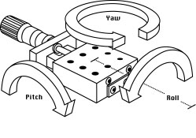
Wrist Movements

Slide 19
Degrees of Freedom
Degrees of freedom is often used to describe the number of directions that a robot can pivot or move a joint.

Slide 20
Further classification of Joints
prismatic joint
L
rotational joint
R
revolving joint
V
twisting joint
T

Slide 21
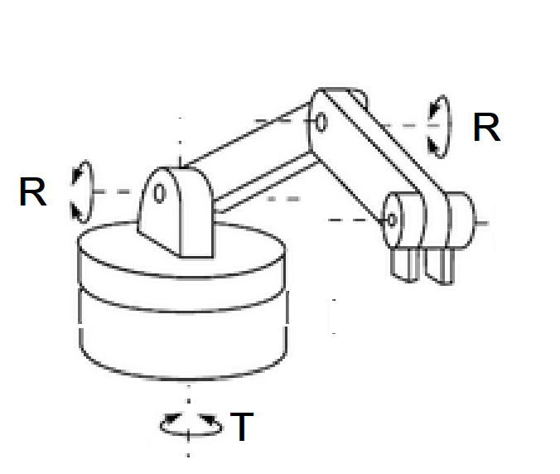
Joint Notation Scheme

Slide 22
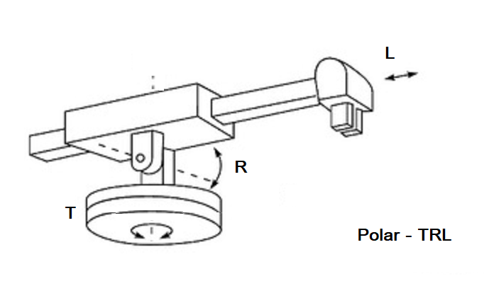
Joint Notation Scheme

Slide 23
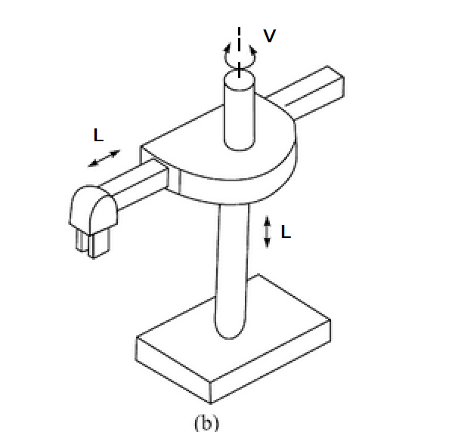
Joint Notation Scheme

Slide 24
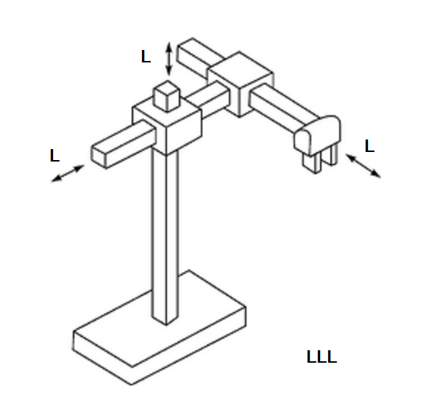
Joint Notation Scheme

Slide 25
Sketch the following arm configurations
For the following arm and body designations describe the robots using sketches
LLR
RLR
LRR
LVR
LL - TRL

Slide 26
Required Degrees of Freedom
For moving objects placed on a line or a circle → 1 dof
For moving objects anywhere on a flat surface → 2 dof
Picking objects anywhere on a 3D space → 3 dof
Reaching into complex profiles → > 3 dof

Slide 27
Required Degrees of Freedom

Slide 28
Required Degrees of Freedom

Slide 29
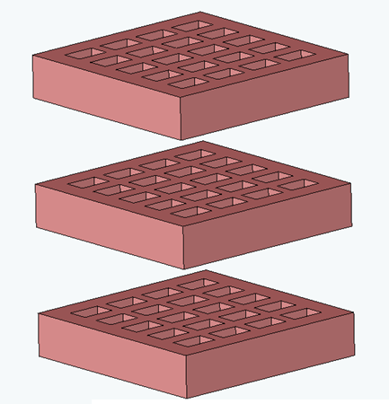
Required Degrees of Freedom

Slide 30
Required Degrees of Freedom

Slide 31
Required Degrees of Freedom

Slide 32
Required Degrees of Freedom

Slide 33
Wrist Configurations
Arm configurations carry and position the wrist, the second major part of a Manipulator, Wrist is attached to the end point of the arm
Wrist subassembly enables the manipulator to orient the end-effector to perform the desired task properly.
The end effector, if gripper, must be oriented at an appropriate angle to pick and grasp a work piece.

Slide 34
Wrist Configurations
For an arbitrary orientation of wrist in 3-D space, the wrist must possess at least 3-DOF.
This 3-DOF gives three rotations about the three principal axes.
Less than 3-DOF wrists are also used depending on the requirement.
Wrist must be compact and at the same time must not affect the performance of the arm.

Slide 35
Wrist Configurations
Two Axis Wrist (RT)
Two Axis Wrist (TR)

Slide 36
Wrist Configurations
Three Axis Wrist (TRT)

Slide 37
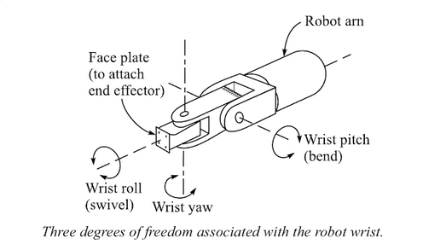
Wrist Configurations
Wrist with Roll, Pitch and Yaw motions is shown below.

Slide 38
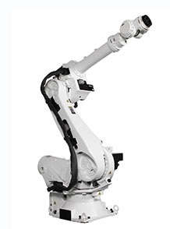
Design and Control Issues
Robots require higher mobility and dexterity than conventional machine tools.
The mechanical structure of a robot consists of rigid cantilever beams connected by hinged joints.
This is inherently poor in stiffness, accuracy and load carrying capacity.

Slide 39
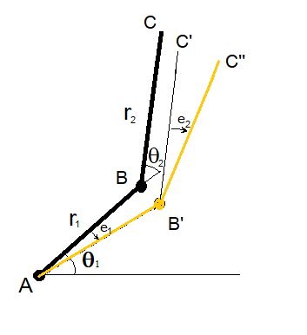
Design and Control Issues
The errors accumulate because the joints are in series.
The position and motion of each joint is affected by the position and motion of other joints.
The weight and inertial load of each link is carried by the previous link and the links undergo rotary and linear motion, making centrifugal and Coriolis accelerations significant.

Slide 40
THANK YOU
The presenter is grateful to the authors of the following textbooks.
Machines and Mechanisms, Applied Kinematic Analysis (Fourth Edition) – David H. Myszka
Industrial Robotics - Mikell P. Groover
Fundamentals of Robotics – Robert Schilling

